Slide 1
Skip this slide. Do not show in the lecture.
Special instruction to the Professor:
The Milgram Experiment is discussed in this lecture.
At the start of the lecture, simply instruct all of the students to stand up, and give no other greeting or direction. Do not start with your normal greeting, etc.
Simply say, “Please stand up.” You may repeat the exact same phrase if some students are non-responsive.
After all students are standing, simple say, “Please sit down.”
Then begin the lecture in the usual manner.
This was a mini-experiment to demonstrate the “position of authority” that a person has over others, as will be explored in this module.
The text colour closely matches the background so as to keep the content hidden if inadvertently displayed on the class screen.
Tee-up Video mm:ss 00:37- 06:19: “The Milgram Experiments”
https://www.youtube.com/watch?v=ZZ-XEAmCmT0&t=2s
Note: The Milgram Video is part of the eClass On-line Study with a quiz; so, there is no need to watch the video in class.
Chapter 7.6 The Power of Leaders to Influence Behaviour
1
Notes:
1

Slide 2


Fundamentals of RM
RM System and Process
Leadership in RM
Incident Investigation
RM Tools & Challenges
RM in Industry
People & Org.
Application and Perspectives
On Becoming a
Leader in Risk Management
ENGG404 – Lecture
Chapter 7.6 The Power of Leaders
to Influence Behaviour

Slide 3
Learning Outcomes:
Critique the relationships between you and:
  your supervisor,
  your peers,
  your subordinates.
Recognize challenges in those relationships.
Explain how to and be able to adjust your interpersonal practices to ensure clear and consistent communication of expectations within those relationships.
Chapter 7.6 The Power of Leaders to Influence Behaviour
3
Notes:
3

Slide 4
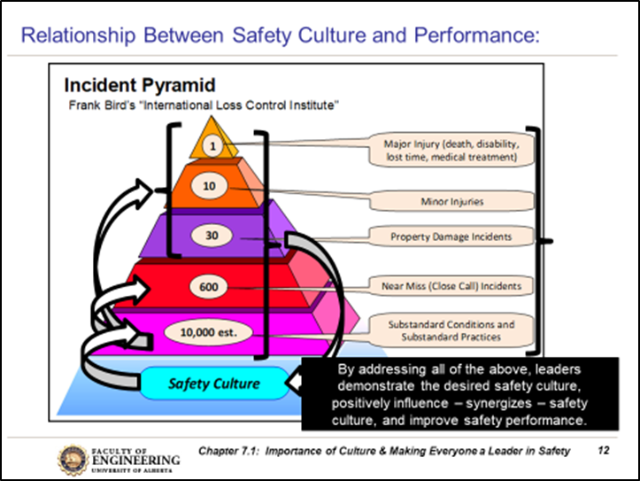
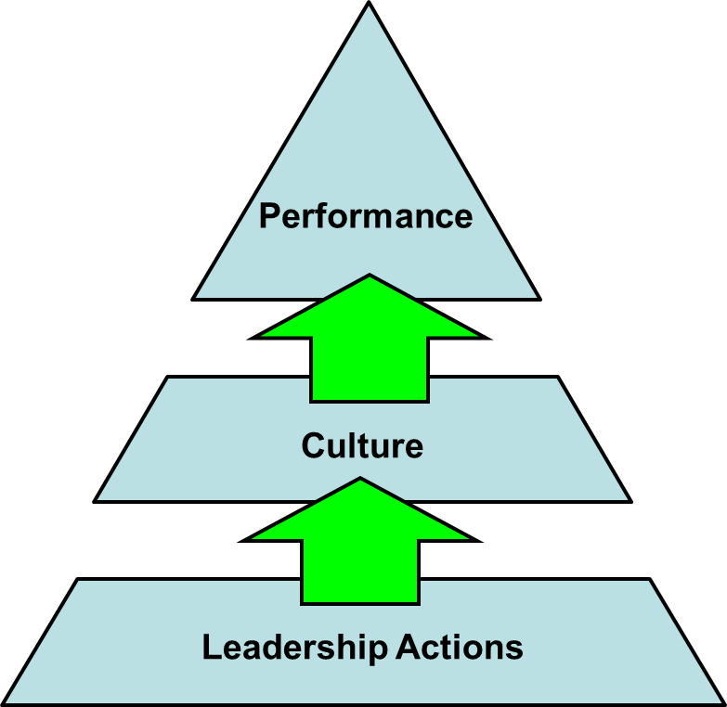
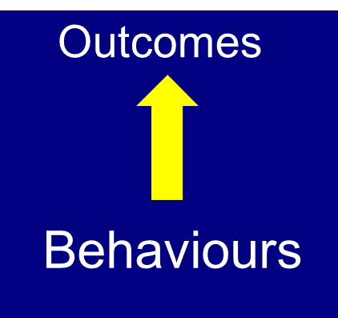
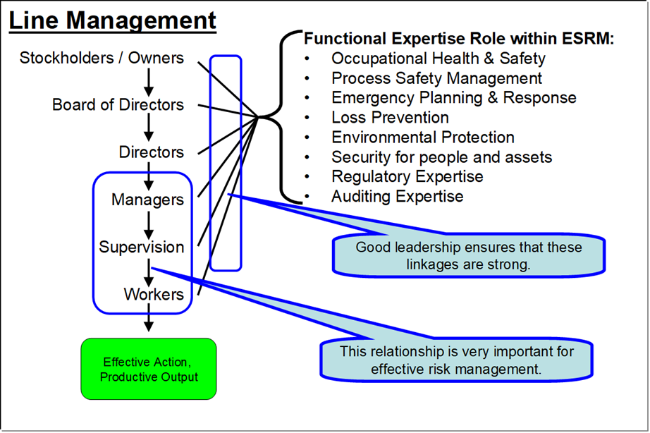
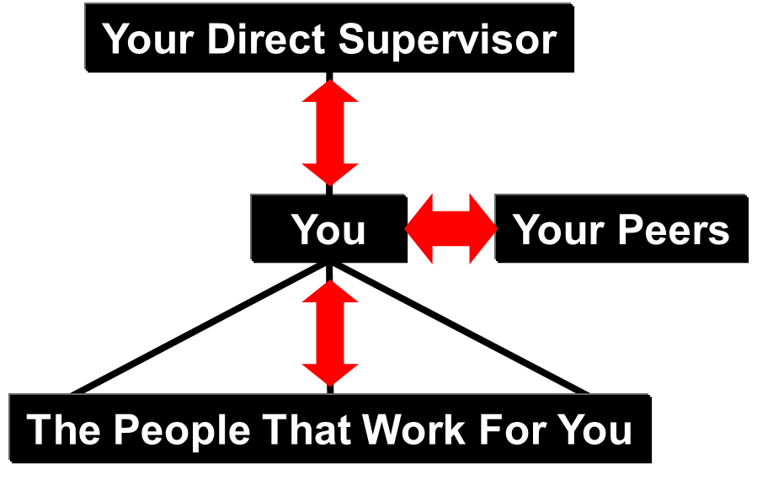
Introduction:
Organizational Culture:
Leaders must provide an organizational
culture that holds “excellence in safety”
as a value.
Focus on Behaviours
  Focus on behaviours to achieve
  desirable outcomes:
  Reduces the occurrence of
  at-risk behaviours …
  Improves safety performance.
Challenge:
The leader, as an influencer,
is in a position of authority!
Chapter 7.6 The Power of Leaders to Influence Behaviour
4
Notes:
4

Slide 5
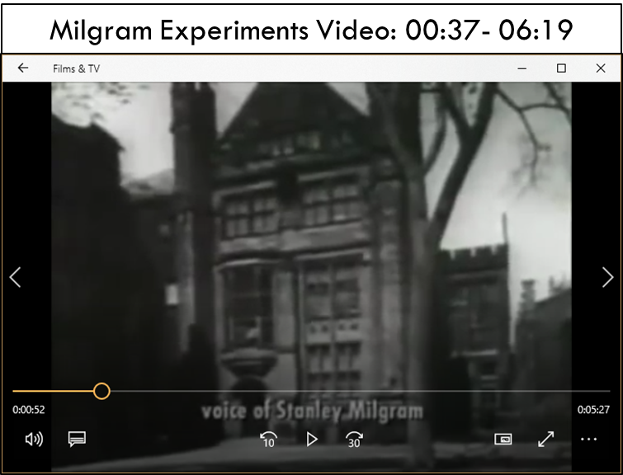
The Key Finding from the Milgram Experiments:
Position of Authority:
“… under what conditions would a person obey authority, who commanded actions that went against conscience?” Stanley Milgram
(Video 00:36-00:48)
“Please continue”
(the unseen voice)
The Questioner /
Punisher
Responder
(inside the booth,
giving staged answers and
getting “staged” shocks)
Chapter 7.6 The Power of Leaders to Influence Behaviour
5
Notes:
5

Slide 6
The Key Finding from the Milgram Experiments:
Position of Authority:
“… under what conditions would a person obey authority, who commanded actions that went against conscience?” Stanley Milgram
(Video 00:36-00:48)
People will do things despite conscience, ethics, values, policies …
… a “state of conflict” that they can excuse themselves of …
… by deferring to the higher authority and a diffusion of responsibility.”
“Please continue”
(the unseen voice)
The Questioner /
Punisher
Responder
(inside the booth,
giving staged answers and
getting “staged” shocks)
Chapter 7.6 The Power of Leaders to Influence Behaviour
6
Notes:
6

Slide 7
The Key Finding from the Milgram Experiments:
Position of Authority:
“… under what conditions would a person obey authority, who commanded actions that went against conscience?” Stanley Milgram
People will do things despite conscience, ethics, values, policies …
… a “state of conflict” that they can excuse themselves of by …
… deferring to the higher authority and a diffusion of responsibility.
“Please continue”
(the unseen voice)
The Questioner /
Punisher
Position of Authority:
In the context of the model of the Line Management so typical for almost every organization, what is the one main finding (conclusion) that we can draw from The Milgram Experiment?
Responder
(inside the booth,
giving staged answers and
getting “staged” shocks)
Chapter 7.6 The Power of Leaders to Influence Behaviour
7
Notes:
7

Slide 8
The Key Finding from the Milgram Experiments:
Position of Authority:
“… under what conditions would a person obey authority, who commanded actions that went against conscience?” Stanley Milgram
People will do things despite conscience, ethics, values, policies …
… a “state of conflict” that they can excuse themselves of by …
… deferring to the higher authority and a diffusion of responsibility.
“Please continue”
(the unseen voice)
The Questioner /
Punisher
Position of Authority:
We find and conclude that …
Position of authority leads to
“obedience to authority” ...
The KEY LESSON for you …
A supervisor carries an incredible amount of influence, something that must be exercised very responsibly.
Responder
(inside the booth,
giving staged answers and
getting “staged” shocks)
Chapter 7.6 The Power of Leaders to Influence Behaviour
8
Notes:
8

Slide 9
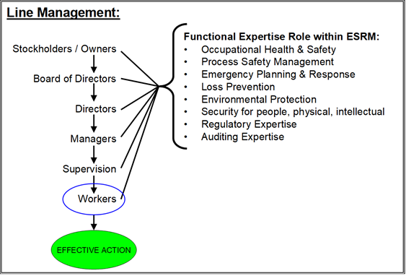
Your Three Key Relationships In Your Career:
Your Three Key Relationships In Your Career and the Relative Positions of Authority as defined by the Line Management Model:
Your Direct Supervisor
You
Your Peers
The People That Work For You
Chapter 7.6 The Power of Leaders to Influence Behaviour
9
Notes:
9

Slide 10
1) You and Your Direct Supervisor:
The first relationship in your Role … you and your supervisor.
Why is this relationship important to you? What are the expectations of you in this role? What challenges can you expect?
Your Direct Supervisor
Position of Authority:
You & Your Supervisor
You
Your Peers
The People That Work For You
Chapter 7.6 The Power of Leaders to Influence Behaviour
10
Notes:
10

Slide 11
1) You and Your Direct Supervisor:
Importance:
Supervising, coaching, mentorship towards development of you.
Career development and advancement.
People are not around “forever”: managers are always looking for good talent to develop, test, and advance to grow the organization – keep it competitive.
Expectations that Your Supervisor has of You:
  Area of responsibility – ESG KP#2 “Understand Your Program”
  Objectives and goals,
  Policies and procedures,
  Directions on tasks, jobs and projects,
  “unwritten rules”.
Chapter 7.6 The Power of Leaders to Influence Behaviour
11
Notes:
11

Slide 12
1) You and Your Direct Supervisor:
Challenges to expect:
Too often the new employee, you, will not ask questions for fear of “looking stupid”.
Too often the supervisor is not a skilled communicator and the message they give is not clear.
Too often the supervisor is busy with other duties and finds it difficult to have enough time to spend with you and does not see the benefit.
Chapter 7.6 The Power of Leaders to Influence Behaviour
12
Notes:
12

Slide 13
1) You and Your Direct Supervisor:
And how to deal with those challenges:
Too often the new employee, you, will not ask questions for fear of “looking stupid”.
  Build rapport early in the relationship to overcome this challenge. “There are no dumb questions.”
Too often the supervisor is not a skilled communicator and the message they give is not clear.
  Take the time and make the effort to understand your supervisor’s expectations – what they want from you, want you to do.
Too often the supervisor is busy with other duties and finds it difficult to have enough time to spend with you and does not see the benefit.
  Take the time and make the effort to briefly review with your supervisor to seek confirmation of your understanding.
Chapter 7.6 The Power of Leaders to Influence Behaviour
13
Notes:
13

Slide 14
1) You and Your Direct Supervisor:
Recall what the Milgram experiments were about:
The power of a position of authority – your supervisor over you!
You do not want to do something under direction of your supervisor, that your supervisor did NOT want you to do!
When seeking direction and clarifying expectations,
especially when directions clash, be open and ask
questions to verify your understanding.
What might at first seem to be conflicting directions,
may not at all be that!
Chapter 7.6 The Power of Leaders to Influence Behaviour
14
Notes:
14

Slide 15
1) You and Your Direct Supervisor:
Some practical advice to work with your direct supervisor:
Strive (work hard) to meet expectations!
  Manage your responsibilities such that there are “no surprises”!
Take the initiative to communicate.
  Seek clarity when directions clash with ethics, values, policies, etc.
  Keep your supervisor informed especially when things are not going per the plan.
FYI: Supervisors want solutions! NOT excuses and
NOT more problems!
Chapter 7.6 The Power of Leaders to Influence Behaviour
15
Notes:
15

Slide 16
2) You and The People That Work For You:
The second relationship in your Role … you and your subordinates,
the people that work for you.
Why is this relationship important to you? Expectations? Challenges?
Your Direct Supervisor
You
Your Peers
Position of Authority:
You are Your Subordinates
The People That Work For You
Chapter 7.6 The Power of Leaders to Influence Behaviour
16
Notes:
16

Slide 17
ALE #1: Challenges - You and The People That Work For You
Please confer (pen-to-paper, MM-Poll):
What challenges can you expect in these relationships?
What can you do to overcome these challenges?
Your Direct Supervisor
You
The People That Work For You
Chapter 7.6 The Power of Leaders to Influence Behaviour
17
Notes:
17

Slide 18
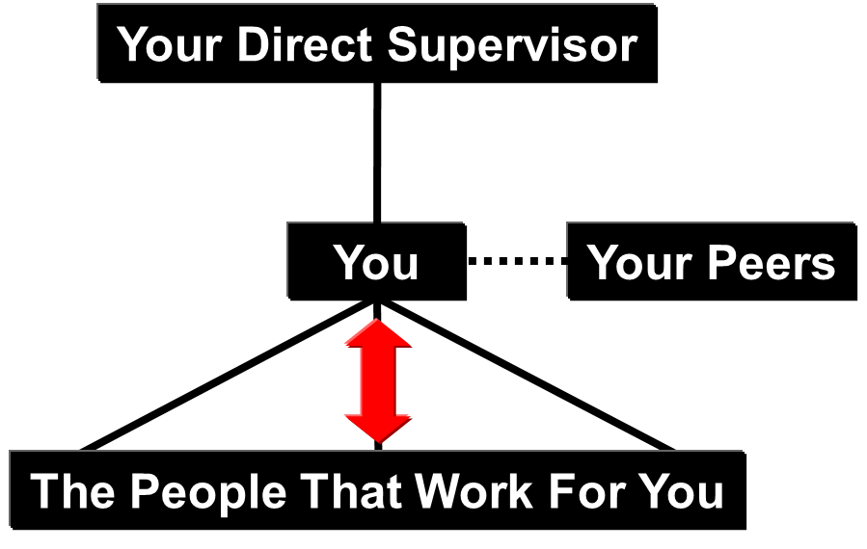
2) You and The People That Work For You:
Same relative position as you to your supervisor:
Challenges:
  They don’t want to ask questions
  for fear of “looking dumb”.
  They may not have the communications
  skills to search or probe for clarity.
  They may not take the initiative to
  schedule time with you.
Everything you do to create a successful relationship with your supervisor, you should coach and expect the same in the people that work for you.
  Build rapport early in the relationship.
  Take the time and make the effort to confirm that they understand your expectations.
  In addition, be sure to recognize and reward them …
  to reinforce their (desirable) behaviours!
Chapter 7.6 The Power of Leaders to Influence Behaviour
18
Notes:
18

Slide 19
2) You and The People That Work For You:
Recall what the Milgram experiments were about:
The power of a position of authority – you over them!
Let your people know what you expect.
  Don’t assume they do! Check for understanding.
  If and when your expectations are confusing or conflicting,
  you must be open and welcoming to their questions.
  Respect the person who comes to you seeking clarity.
Set realistic expectations and uphold those expectations!
  “Walk the talk”.
  “Lead by example.”
  Never compromise your expectations.
    but adjust as work progresses and realities emerge …
Chapter 7.6 The Power of Leaders to Influence Behaviour
19
Notes:
19

Slide 20
3) You and Your Peers:
The third relationship in your Role … you and your peers
Why is this relationship important to you? Expectations? Challenges?
Your Direct Supervisor
Is there a
Position of Authority?
You
Your Peers
The People That Work For You
Chapter 7.6 The Power of Leaders to Influence Behaviour
20
Notes:
20

Slide 21
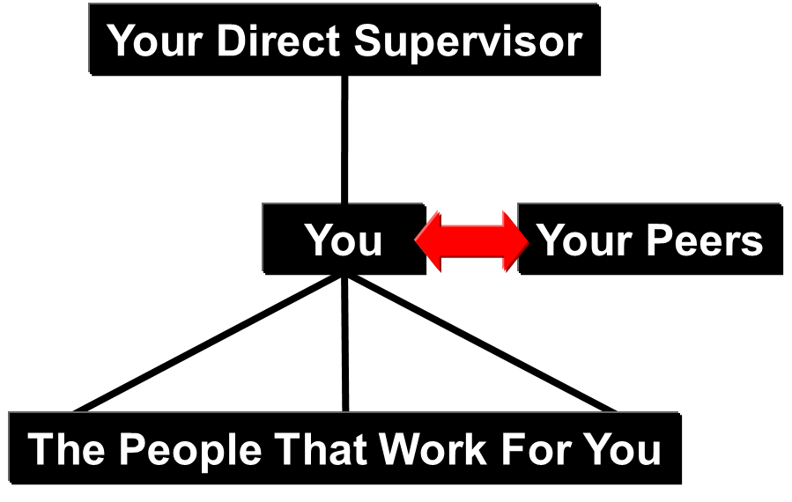
3) You and Your Peers:
Peers:
There is no practical “position of authority” but
there most likely will be in the future.
Yet there could be a “position of
authority” based on one’s stature
as an “influencer”.
You are building associations and
relationships for the future with your
future peers, your future supervisors,
and with your future subordinates.
  Career paths will cross, and
  careers will advance.
  Interdependence on working
  towards the same goal:
  a successful organization.
Chapter 7.6 The Power of Leaders to Influence Behaviour
21
Notes:
21

Slide 22
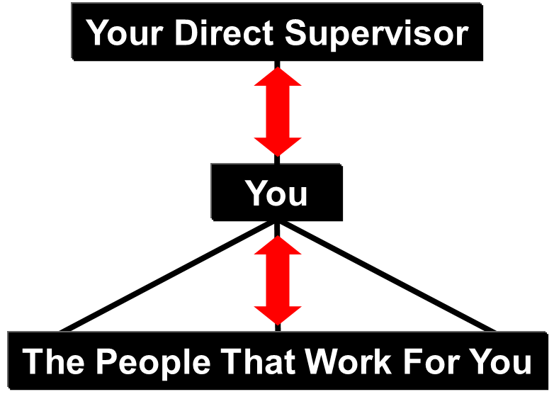
Responsible, Accountable, Line Management and Two Key Relationships:
The Line Management Model & Two (of the 3) Key Relationships:
Relative Positions of Authority as defined by the Models:
Between You & Your Direct Supervisor, and
Between You & The People that Work
for You
Who is responsible?
Who is accountable?
TheLine Management Model:
Stockholders / Owners
Board of Directors
Directors / Executives
Managers
Supervisors
Workers
Effective Action
Chapter 7.6 The Power of Leaders to Influence Behaviour
22
Notes:
22

Slide 23
RACI: Responsible – Accountable – Consulted - Informed:
New Concept - RACI:
When clarifying roles, responsibilities, and making decisions within organizations, the acronym “RACI” is sometimes used
If the understanding of who is responsible, who is accountable, etc. is lacking, there is confusion within the organization
R = Responsible Person: the person who has a duty to perform
i.e. “is the doer of a task”, and that person is responsible for
fulfilling those duties
A = Accountable Person: the person who makes sure a requirement is being
met, makes sure a duty is being performed
C = Consulted: the person(s) with whom you consult for input or
feedback to reach or make decisions
I = Informed: whom you inform about decisions being made
In your careers, you may find yourself in all of these roles as you progress.
Chapter 7.6 The Power of Leaders to Influence Behaviour
23
Notes:
23

Slide 24
Line Management and RACI:
TheLine Management Model:
Responsible – Accountable in RACI:
R = Responsible Person:
Each role has a set of responsibilities
A = Accountable Person:
This person holds the responsible person accountable for their work, and is normally the supervisor of the responsible person
All roles above “Workers” hold those below them accountable for their work
Example:
The worker is responsible for operating heavy equipment per operating procedures
The supervisor is accountable for the people working for them i.e. the supervisor checks that the worker is fulfilling their duties i.e. the worker follows the operating procedures, AND holds the worker accountable for their work
Stockholders / Owners
Board of Directors
Directors / Executives
Managers
Supervisors
Workers
Effective Action
Chapter 7.6 The Power of Leaders to Influence Behaviour
24
Notes:
24
There is a chain of command in every organization
Line management is responsible and accountable for managing risk of their activities and their operations not the persons in the functional expertise roles
The functional experts are responsible for providing input to all levels of line mgmt. and are often shared amongst different levels of operations

Slide 25
Who is Responsible and Who is Accountable?
Let’s examine the meanings of these words:
The meanings sound like they are the same, but they are not!
Responsibility: an expectation or obligation (i.e. a set of duties, tasks, or goals) that is imposed on or assigned to a person
Responsible person:
The person who is expected to do something (i.e. is assigned a set of duties, tasks, or goals), and is charged with (must fulfil) meeting or exceeding those expectations; in other words, one is responsible for their work, AND
The person who either enjoys the positive consequences for meeting or exceeding those expectations, or suffers the negative consequences for failing to do so; in other words, one is accountable for the performance of their work
Accountability: the application of consequences, either i) positive for meeting or exceeding those expectations, or ii) negative for failing to do so; the consequences are commensurate with the performance (quality, quantity, timing, etc.) of the work
Accountable person.
The person who applies the consequences to the responsible person.
Simply:
The responsible person is “the doer”.
The accountable person “checks that the doer has done their job, and
applies appropriate consequences”.
Chapter 7.6 The Power of Leaders to Influence Behaviour
25
Notes:
25

Slide 26
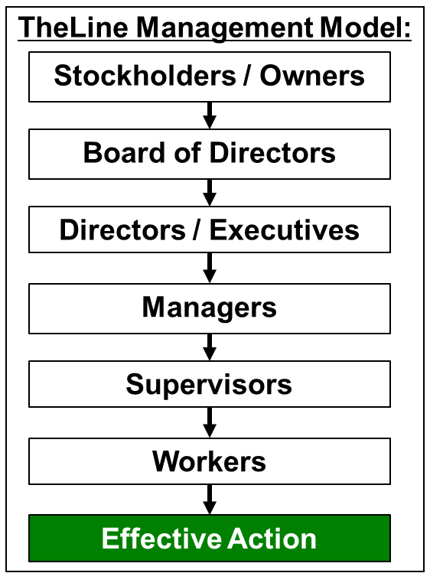
Responsible, Accountable, Line Management and Two Key Relationships:
The Two (of the 3) Key Relationships:
Relative Positions of Authority as defined by the Models:
Between You and Your Direct Supervisor, and
Between You and The People that Work for You
So, in the context of the two models:
The people that work for you are responsible for
the work they do.
You, the supervisor, are accountable for your people and
must hold your people accountable for the performance
of their work.
Moving up in the Models,
You, the supervisor, are responsible for supervising
your people e.g. directing their work and holding them
accountable for the performance of their work.
Your direct supervisor must hold you accountable for
your performance in supervising the people that work for you.
Chapter 7.6 The Power of Leaders to Influence Behaviour
26
Notes:
26

Slide 27
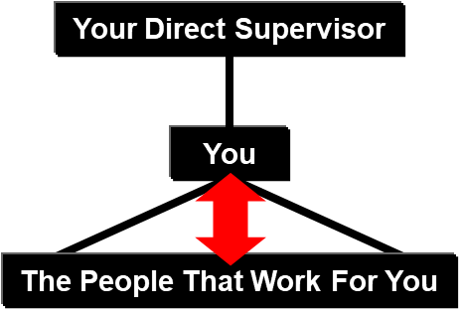
Responsible, Accountable, Line Management and Two Key Relationships:
The People that Work for You and You – an explanation in more detail:
The people that work for you (the workers) are
responsible for the duties that they perform.
You, the supervisor of the workers, are responsible
for the people that work for you:
You direct them in their work i.e. you assign
work to them, and
You must hold the people that work for you
accountable for their performance:
You check on their performance AND
You apply consequences based
on their performance:
Positive: you commend your workers for their
performance that meets or exceeds expectations;
Negative: you “coach your workers to be successful ”
i.e. re-train, mentor, correct their behaviours, perhaps reprimand or demote or terminate, for work that does not meet expectations.
Chapter 7.6 The Power of Leaders to Influence Behaviour
27
Notes:
27

Slide 28
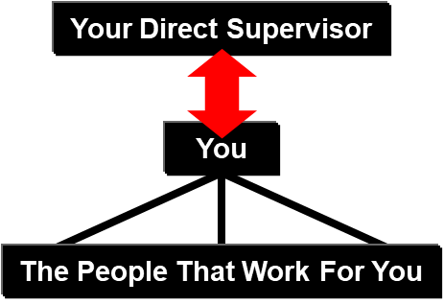
Responsible, Accountable, Line Management and Two Key Relationships:
You and Your Direct Supervisor - explanation in more detail:
Your direct supervisor:
Is responsible for supervising you, and
Must hold you accountable for how you
supervise the people that work for you.
Thus, your direct supervisor MUST hold you,
accountable for your performance in order to
fulfil their duties. In other words:
They check on your performance, AND
They apply consequences based on your performance:
Positive: your direct supervisor commends you for your
performance that meets or exceeds expectations; OR
Negative: they “coach you to be successful ” i.e. re-train, mentor, correct your behaviours, perhaps reprimand or demote or terminate, for
work that does not meet expectations.
Chapter 7.6 The Power of Leaders to Influence Behaviour
28
Notes:
28

Slide 29
Responsible, Accountable, Line Management and Two Key Relationships:
In any organization, people are assigned responsibilities and are held accountable for the performance of their responsibilities.
This interconnection of responsibilities and accountabilities
Moves up through the Models …
Drives individuals and the organization towards successful achievement of mutual goals.
Does an example of this model come to mind?
The responsible person is “the doer”.
The accountable person “checks that the doer has done their job, and
applies appropriate consequences”.
Chapter 7.6 The Power of Leaders to Influence Behaviour
29
Notes:
29

Slide 30
ALE #2: Line Management and RACI
TheLine Management Model:
Responsible and Accountable:
Please confer (MM-Poll):
In the model depicted, given that the Supervisor is:
responsible for checking that the worker is fulfilling their duties AND
responsible for holding the worker accountable for their work,
What is the Manager’s role?
The Manager is the person accountable for:
(choices are noted on Mentimeter)
…
Stockholders / Owners
Board of Directors
Directors Executives
Managers
Supervisors
Workers
Effective Action
Chapter 7.6 The Power of Leaders to Influence Behaviour
30
Notes:
30
There is a chain of command in every organization
Line management is responsible and accountable for managing risk of their activities and their operations not the persons in the functional expertise roles
The functional experts are responsible for providing input to all levels of line mgmt. and are often shared amongst different levels of operations

Slide 31
Example: Line Management and RACI
TheLine Management Model:
Responsible and Accountable:
In the model depicted, given that the Supervisor is:
responsible for checking that the worker is fulfilling their duties AND
responsible for holding the worker accountable for their work,
The Manager is the person accountable for:
The supervisor’s performance.
Checking that the Supervisor has fulfilled their duties and holds the Supervisor accountable for their work.
The overall performance of the organization based on the performance of the workers and their supervisor.
Directing on a daily basis the activities of the workers. X
Checking on the daily basis the activities of the workers. X
The last two are the responsibilities of the Supervisor!
Stockholders / Owners
Board of Directors
Directors Executives
Managers
Supervisors
Workers
Effective Action
Chapter 7.6 The Power of Leaders to Influence Behaviour
31
Notes:
31
There is a chain of command in every organization
Line management is responsible and accountable for managing risk of their activities and their operations not the persons in the functional expertise roles
The functional experts are responsible for providing input to all levels of line mgmt. and are often shared amongst different levels of operations

Slide 32
Example: Responsible, Accountable, and the Two Models:
Case Study: You and your team are responsible for undertaking and completing a Team Project Report for your course term work. Let’s apply the Two Models in terms of responsibilities and accountabilities, centric to You, the workers:
The Each of you (the “workers”) is responsible:
You engage with your team-mates, and complete your work on
the Team Project Report to which you agreed;
You receive the consequences for your level of engagement, and
the quality and / or quantity of your assigned work; in other words,
the feedback, the mark, and any allowable deductions you get!
Your professor (your “supervisor”) is responsible:
Teaches (directs) you on the requirements of the team project report;
Assesses you a grade (applies the consequences / holds you
accountable) on your Team Project Report;
Receives the consequences of their performance.
Your professor’s supervisor (the Chair of the Department) is responsible:
Directs the professors on their academic activities i.e. assignments for teaching, etc.
Assesses the performance of the professor (e.g. how well they: teach, assess / grade students in a fair and equitable manner; and how well the students do),
Holds the professor accountable for the professor’s performance, and:
Commends the professor for performance that meets or exceeds expectations (pay raise?), or
Coaches the professor how to improve, to become more successful
As demonstrated, this interconnection of responsibilities and accountabilities
Moves up through the organization
Drives individuals and the organization towards successful achievement of mutual goals, in this case, an exceptional education.
Your Professor’s Supervisor
(Department Chair)
Your Professor
You, the Students
Chapter 7.6 The Power of Leaders to Influence Behaviour
32
Notes:
32

Slide 33
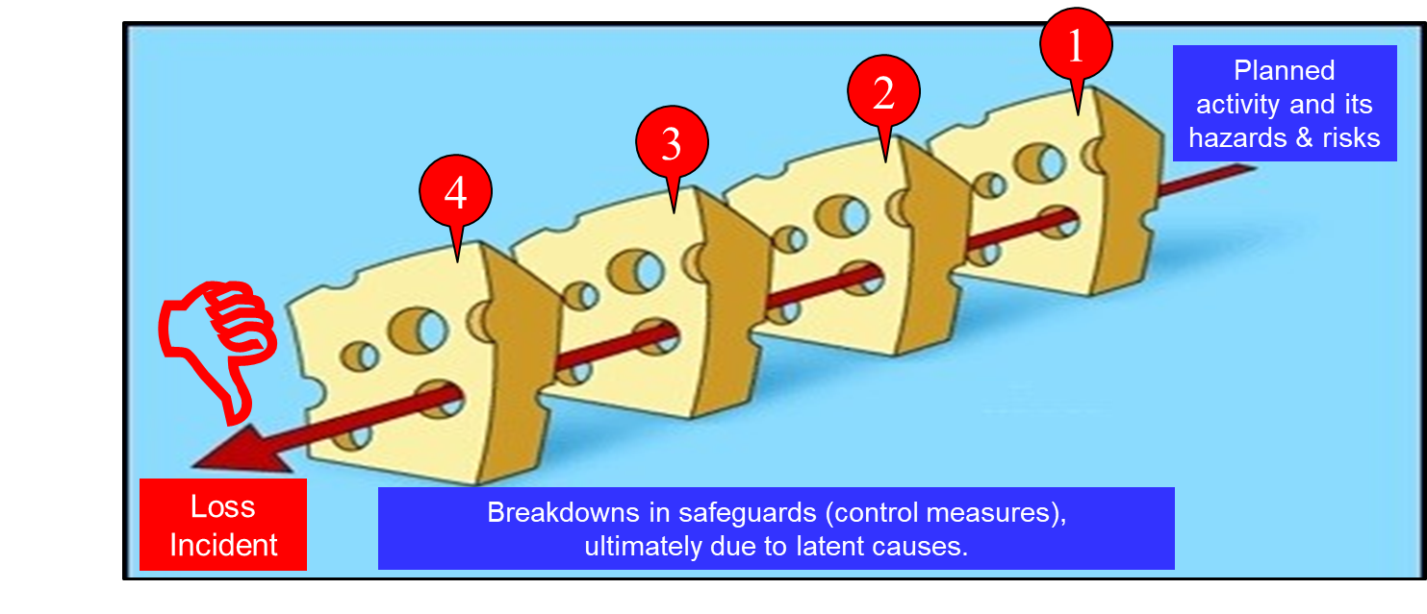
RME #1 MLCA and Responsibility and Accountability:
Relate An Individuals’ Responsibility And Accountability To
A Loss Incident and Latencies in a RM System / Program:
In dealing with a person(s) involved in a loss incident within the field of risk management, it is WRONG to immediately assign blame to the worker and punish the worker i.e. to terminate or “fire” the worker.
Instead, leaders must first search for latent causes:
What in the risk management system and its programs
allowed the worker(s) to “do something wrong”?
Did the RMS/RMP give “only bad choices” to the worker?
Chapter 7.6 The Power of Leaders to Influence Behaviour
33
Notes:
33

Slide 34
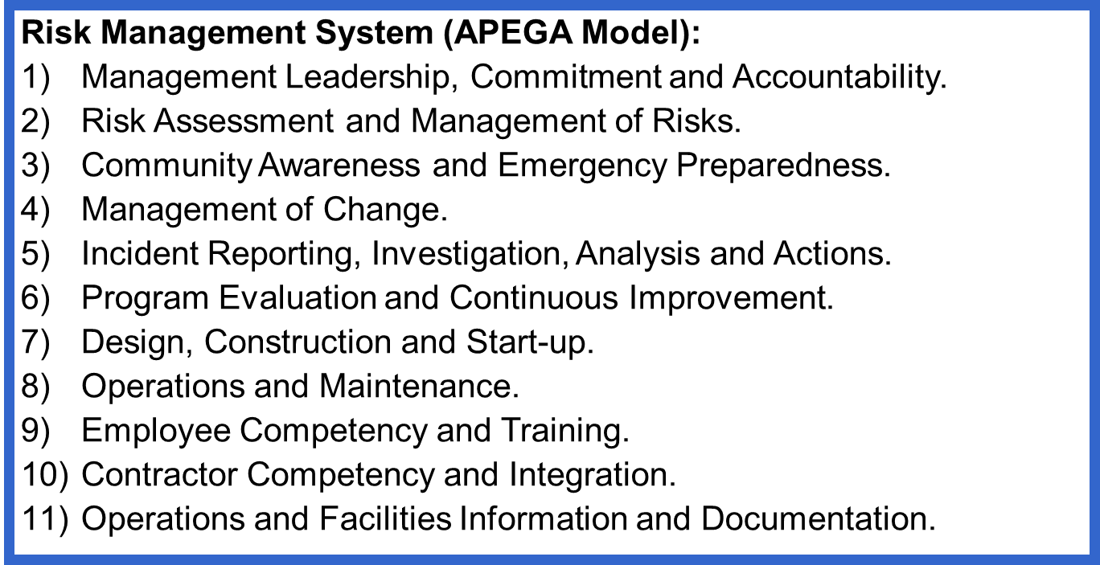
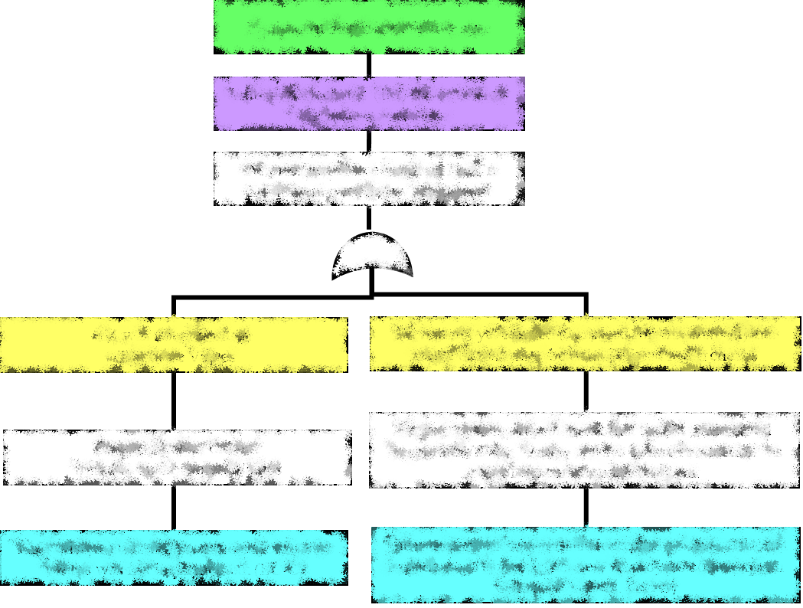
ALE #3: RME #1 MLCA - Responsibility and Accountability
Please confer and respond (open discussion):
In response to the question, “What in the risk management system and its programs allowed the worker(s) to ‘do something wrong’?”, what questions should cause the leader to ask through an RCA to find the LC’s in the RME”s?
Chapter 7.6 The Power of Leaders to Influence Behaviour
34
Notes:
34
There is a chain of command in every organization
Line management is responsible and accountable for managing risk of their activities and their operations not the persons in the functional expertise roles
The functional experts are responsible for providing input to all levels of line mgmt. and are often shared amongst different levels of operations

Slide 35
RME #1 MLCA - Responsibility and Accountability:
The question, “What in the risk management system and its programs allowed the worker(s) to ‘do something wrong’?”, may cause – should cause – the leader to ask through an RCA to find the LC’s in the RME”s, any question such as:
Were the hazards of the activities adequately assessed and were the control measures adequately implemented? LC’s in #2 RAMR
Was the worker adequately prepared (communications, training) for any changes that were made? LC’s in #4 MOC
Were any previous incidents, near misses, or sub-standard conditions / practices reported, investigated, analyzed, and corrected? LC’s in #5 IRIAA
Was management oversight checked (audited, verified) for adequacy and were actions taken to correct or improve on any of the risk management programs and standards of the system elements? LC’s in #6 PECI
Was the design and/or construction and/or startup (commissioning) of the equipment / process / materials suitable for human interfaces? #7 DCSU
Was the equipment / process / materials operated / maintained to standards? #8 OM
Was the worker properly trained in the activity, the risks associated with the activity, and the control measures for those risks? LC’s in #9 EC&T
Was the contractor (as a worker or as a company) adequately screened for competencies, and suitably integrated into the organization’s RMP/RMS to perform work at an acceptable level? #10 CCI
Was all information up-to-date, and readily and easily available and accessible to the workers? #11 OFID
Chapter 7.6 The Power of Leaders to Influence Behaviour
35
Notes:
35

Slide 36
RME #1 MLCA - Responsibility and Accountability:
Finally, if all LC’s relating to management system elements and their programs and program standards have been resolved, then LC’s in #1 MLCA become evident and relate to lack of compliance with program standards of all other elements.
So, is now the time to “fire” the worker i.e. apply severe consequences)?
No, not yet!
Two questions now arise:
Has Leadership set expectations, and does the leader demonstrate commitment to those expectations?
Is it clear that the worker knowingly, or purposefully, or repeatedly, disregarded those standards and put themself or others (or environment, assets, or productive output) at risk of harm?
If the responses are “yes” to both, then the leader moves into a situation where the leader MUST hold the worker accountable for putting themself or others (or E, A, or P) at risk, and MUST terminate the worker.
Chapter 7.6 The Power of Leaders to Influence Behaviour
36
Notes:
36

Slide 37

Summary and Key Lessons:
Position of authority leads to “obedience to authority”:
The KEY LESSON for you:
A supervisor carries an incredible
amount of influence, something that
must be exercised very responsibly.
The three key relationships in your
career have challenges and these
must be managed for a successful career.
In the position and exercising of authority,
there is an interconnection of responsibilities
and accountabilities which drives individuals
and organizations towards achieving mutual goals.
Effective leadership includes not only commitment,
but also accountability. #1 MLCA!
Chapter 7.6 The Power of Leaders to Influence Behaviour
37
Notes:
37

Slide 38
Any questions?
Notes:
38

Slide 39
Working slide – not for presentation
Your Direct Supervisor
You
Your Peers
The People That Work For You
Chapter 7.6 The Power of Leaders to Influence Behaviour
39
Notes:
39

Slide 40
Working slide – not for presentation
Your Direct Supervisor
Your Direct Supervisor
You
You
The People That Work For You
The People That Work For You
Chapter 7.6 The Power of Leaders to Influence Behaviour
40
Notes:
40

